Slide 1
Structured Prediction for Semantic Parsing: A Case Study on Sequential Question Answering
Scott Wen-tau Yih

Slide 2
Semantic Parsing: A Rich Structured Prediction Problem
A semantic parser maps a natural-language sentence to a complete, detailed semantic representation: logical form or meaning representation.
[Optional] For many applications, the desired output is immediately executable by another program.
[Adapted from Ray Mooney “Learning for Semantic Parsing” CICLing-2007 talk]

Slide 3
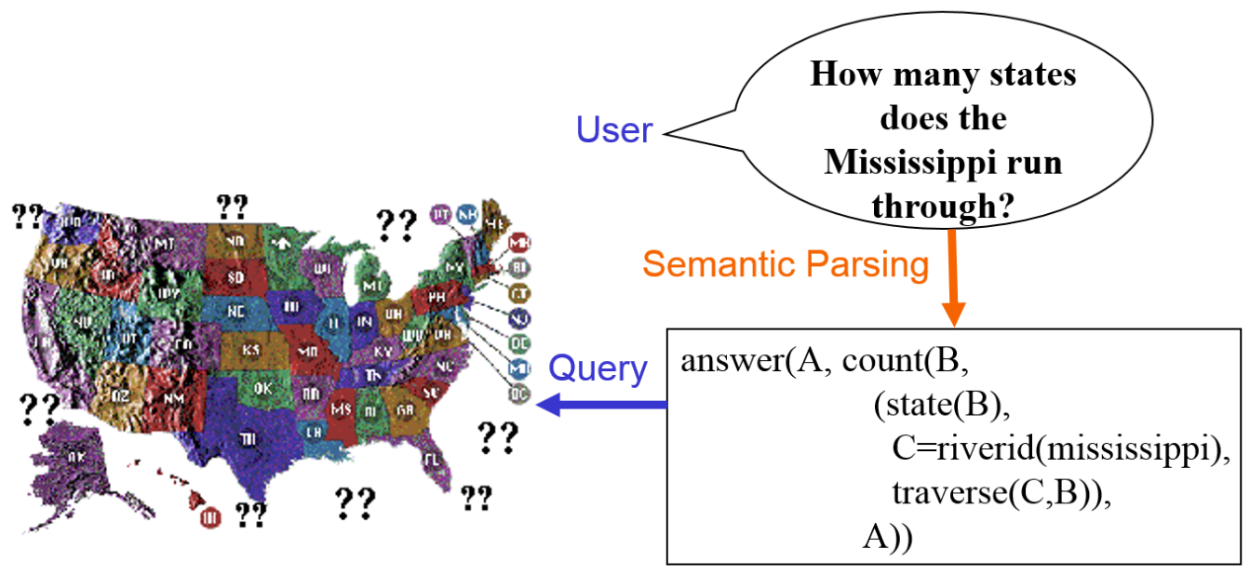
GeoQuery: A Database Query Application
Query application for U.S. geography database containing about 800 facts [Zelle & Mooney, 1996]
[Adapted from Ray Mooney “Learning for Semantic Parsing” CICLing-2007 talk]

Slide 4
The “Structures” in Semantic Parsing
Correct syntax? Executable?

Slide 5
The “Structures” in Semantic Parsing
Correct semantics?

Slide 6
Outline
Introduction to a variety of “semantic parsing” problems
Common technical challenges
DynSP: Search-based Neural Structured Learning for Sequential Question Answering

Slide 7




Answer Questions Using Structured Data
Information Source: A “database”
Tables
Collections of records
Large-scale DB with complex schema
Input: A natural language question (instead of a formal “query”)
Output: Answer
Which AL team won the most games in a season?
2001 Seattle Mariners
Record: 116-46
Manager: Lou Piniella

Slide 8
Semantic Parsing (of Questions)
SELECT Top 1 Team, Record, Manager WHERE League = ‘American League’ ORDER BY Wins DESC
Which AL team won the most games in a season?
2001 Seattle Mariners
Record: 116-46
Manager: Lou Piniella

Slide 9
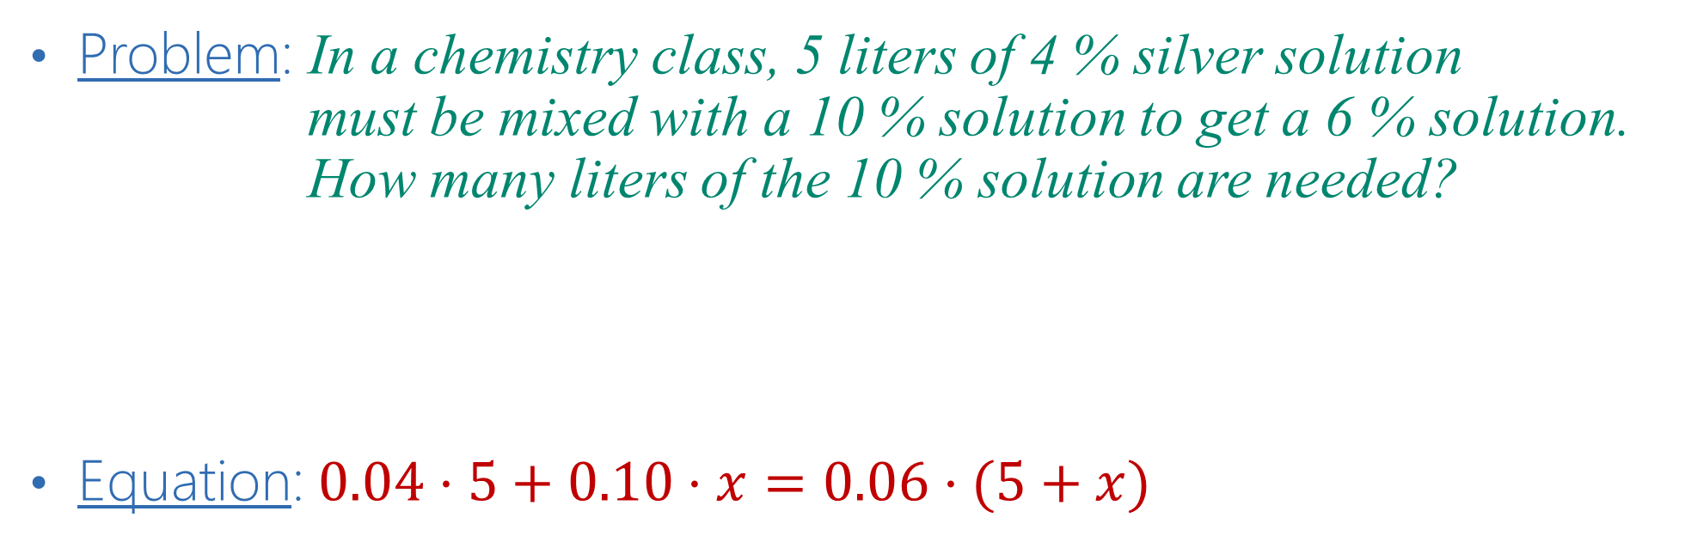
Algebra Word Problem
Problem: In a chemistry class, 5 liters of 4 % silver solution must be mixed with a 10 % solution to get a 6 % solution. How many liters of the 10 % solution are needed?
Equation: $0.04⋅5+0.10⋅x=0.06⋅(5+x)$

Slide 10
Language to Code: If-then Statements [Quirk+ 2015]
“Autosave your Instagram photos to Dropbox”
IF Instagram.AnyNewPhotoByYou THEN Dropbox.AddFileFromURL ( FileURL = {SourceUrl}, FileName = {Caption}, DropboxFolderPath = IFTTT/Instagram )

Slide 11
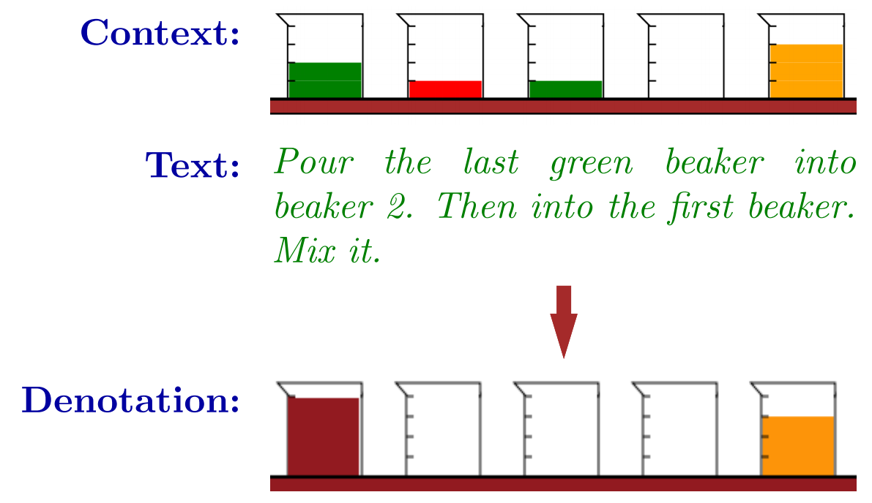
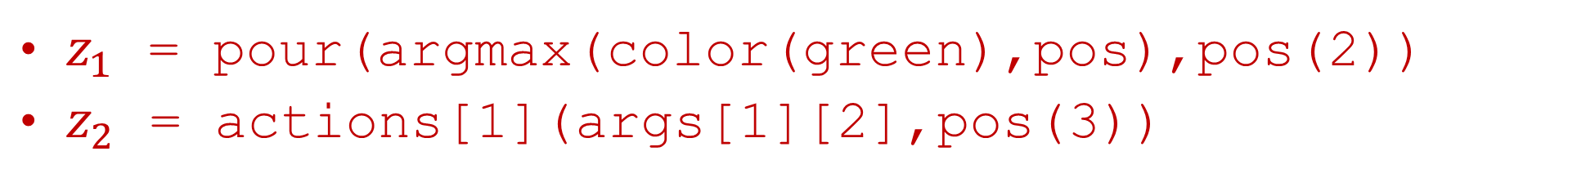
Sequential CONtext-dependent Execution dataset [Long+ 2016]
Task: Execute a sequence of actions according to the instructions
[Fig. 1 of Long et al., ACL-2016]
$z_{1}$ = pour(argmax(color(green),pos),pos(2))
$z_{2}$ = actions[1](args[1][2],pos(3))

Slide 12
Common Technical Challenges
Scarce labeled data for training
Learning from various kinds of supervision signals
Complex semantic matching problems
End-to-End training may not perform well
Mixture of components & modular system design may be needed
Compositionality
Model the structure explicitly
Reduce to contextual & interactive scenarios
Large search space
Leverage domain-specific heuristics in the models

Slide 13
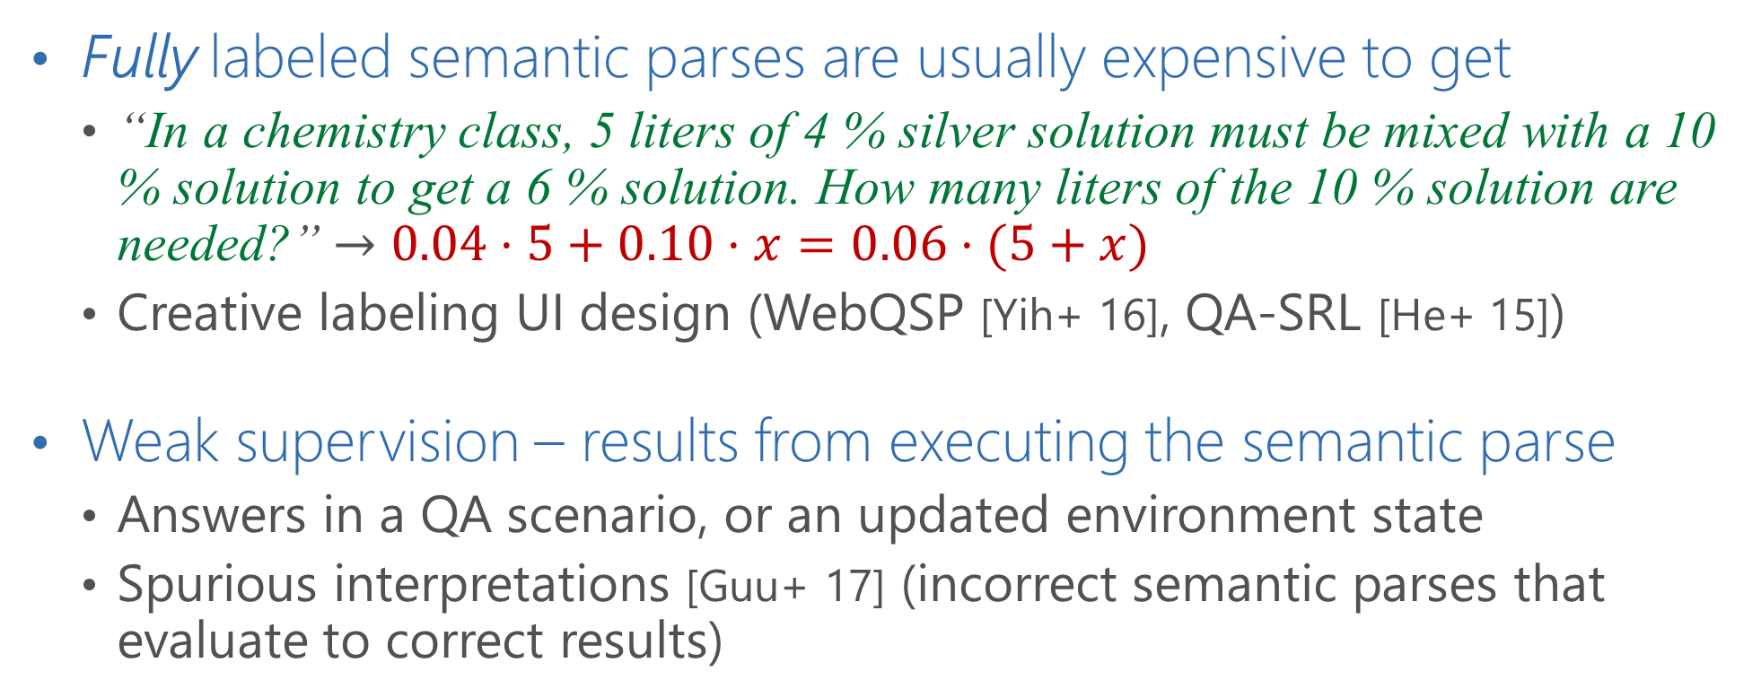
Scarce Labeled Data & Supervision Signals
Fully labeled semantic parses are usually expensive to get
“In a chemistry class, 5 liters of 4 % silver solution must be mixed with a 10 % solution to get a 6 % solution. How many liters of the 10 % solution are needed?” $→$ $0.04⋅5+0.10⋅x=0.06⋅(5+x)$
Creative labeling UI design (WebQSP [Yih+ 16], QA-SRL [He+ 15])
Weak supervision – results from executing the semantic parse
Answers in a QA scenario, or an updated environment state
Spurious interpretations [Guu+ 17] (incorrect semantic parses that evaluate to correct results)

Slide 14
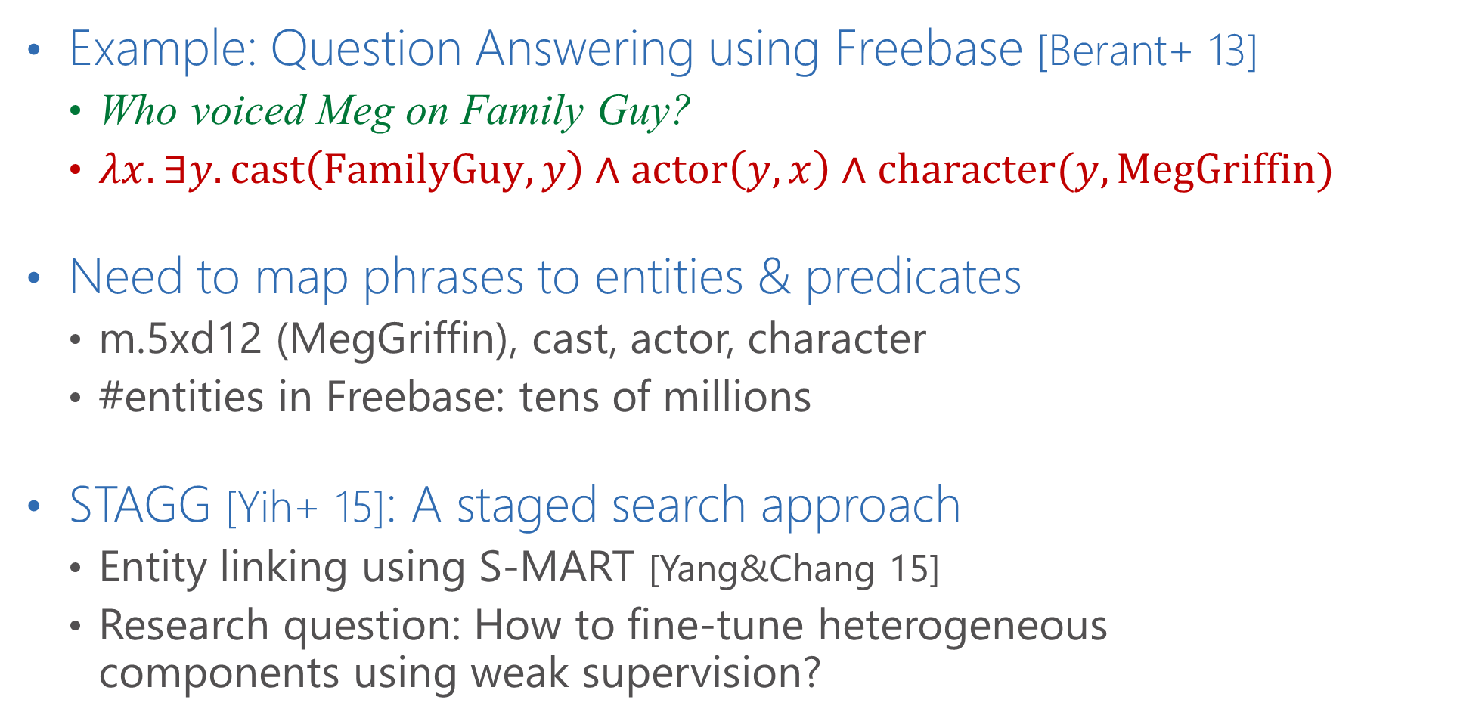
Complex Semantic Matching
Example: Question Answering using Freebase [Berant+ 13]
Who voiced Meg on Family Guy?
$λx. ∃y. cast\left(\text{FamilyGuy}, y\right)∧actor\left(y,x\right)∧character(y, MegGriffin)$
Need to map phrases to entities & predicates
m.5xd12 (MegGriffin), cast, actor, character
#entities in Freebase: tens of millions
STAGG [Yih+ 15]: A staged search approach
Entity linking using S-MART [Yang&Chang 15]
Research question: How to fine-tune heterogeneous components using weak supervision?

Slide 15
Compositionality
Principle of compositionality [Wikipedia]
Meaning of a complex expression is determined by the meanings of its constituent expressions and the rules used to combine them
Example: Complex questions
“Who are the directors of movies stared by Tom Hanks?”
CYK parsing [Bao+ 14]
A more natural scenario: conversational QA
“Which movies did Tom Hanks start?”
“Who are the directors?”
Research question: How to handle the contextual information?

Slide 16
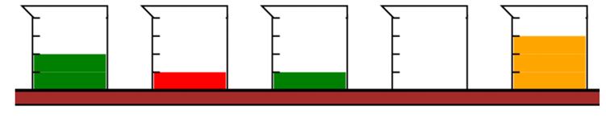
Large Search Space
# legitimate candidate semantic parses grows exponentially
Example in SCONE:
“Pour the last green beaker into beaker 2.”
pour(argmax(color(green),pos),pos(2))
Typical strategies in practice
Restricted solution space (e.g., templates in algebra word problem)
Limit the length of the semantic parses
Domain-specific heuristics to guide search or to bias sampling

Slide 17
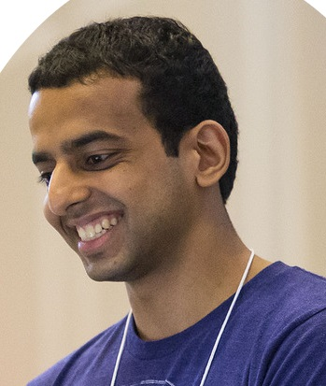
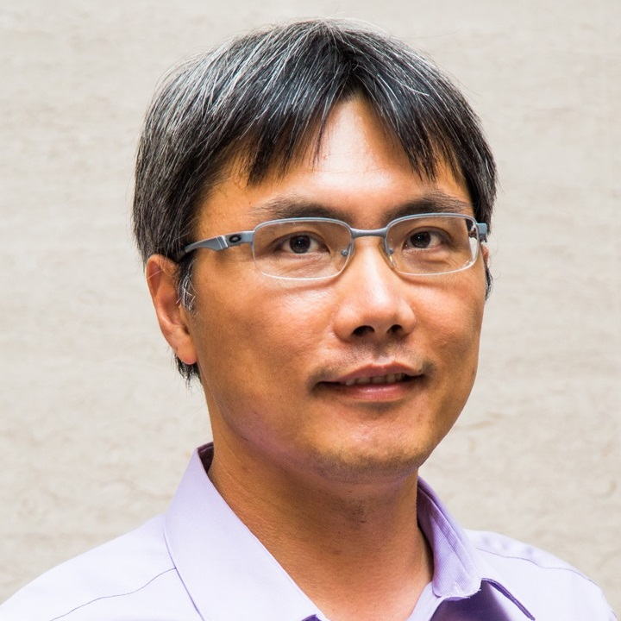

Search-based Neural Structured Learning for Sequential Question Answering
Mohit Iyyer, Wen-tau Yih, Ming-Wei Chang. ACL-2017

Slide 18
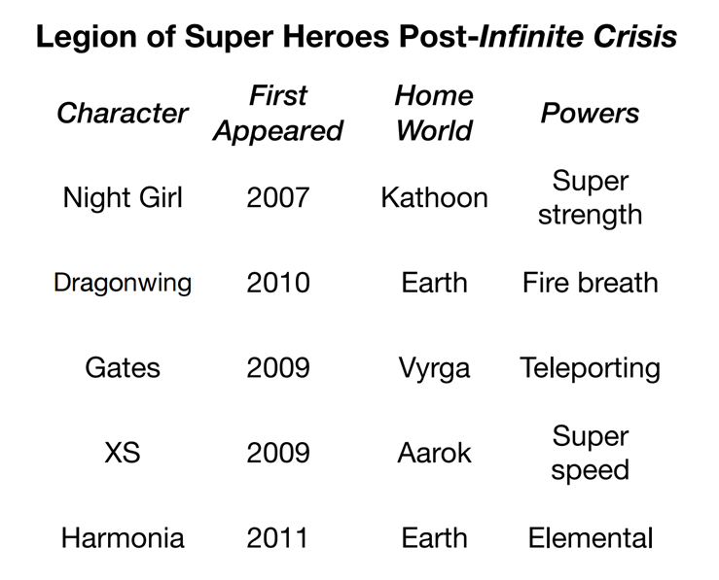
Answer Highly Compositional Questions
“What is the power of the super hero who is from the most common home world and appeared after 2010?”
Challenging research problem
Advocated in semantic parsing [Pasupat & Liang 2015]
But, a natural way to interact with a question answering system?

Slide 19
Answer Sequences of Simple Questions
Who are the super heroes from Earth?
Dragonwing and Harmonia
Who appeared after 2010?
Harmonia
What is her power?
Elemental

Slide 20
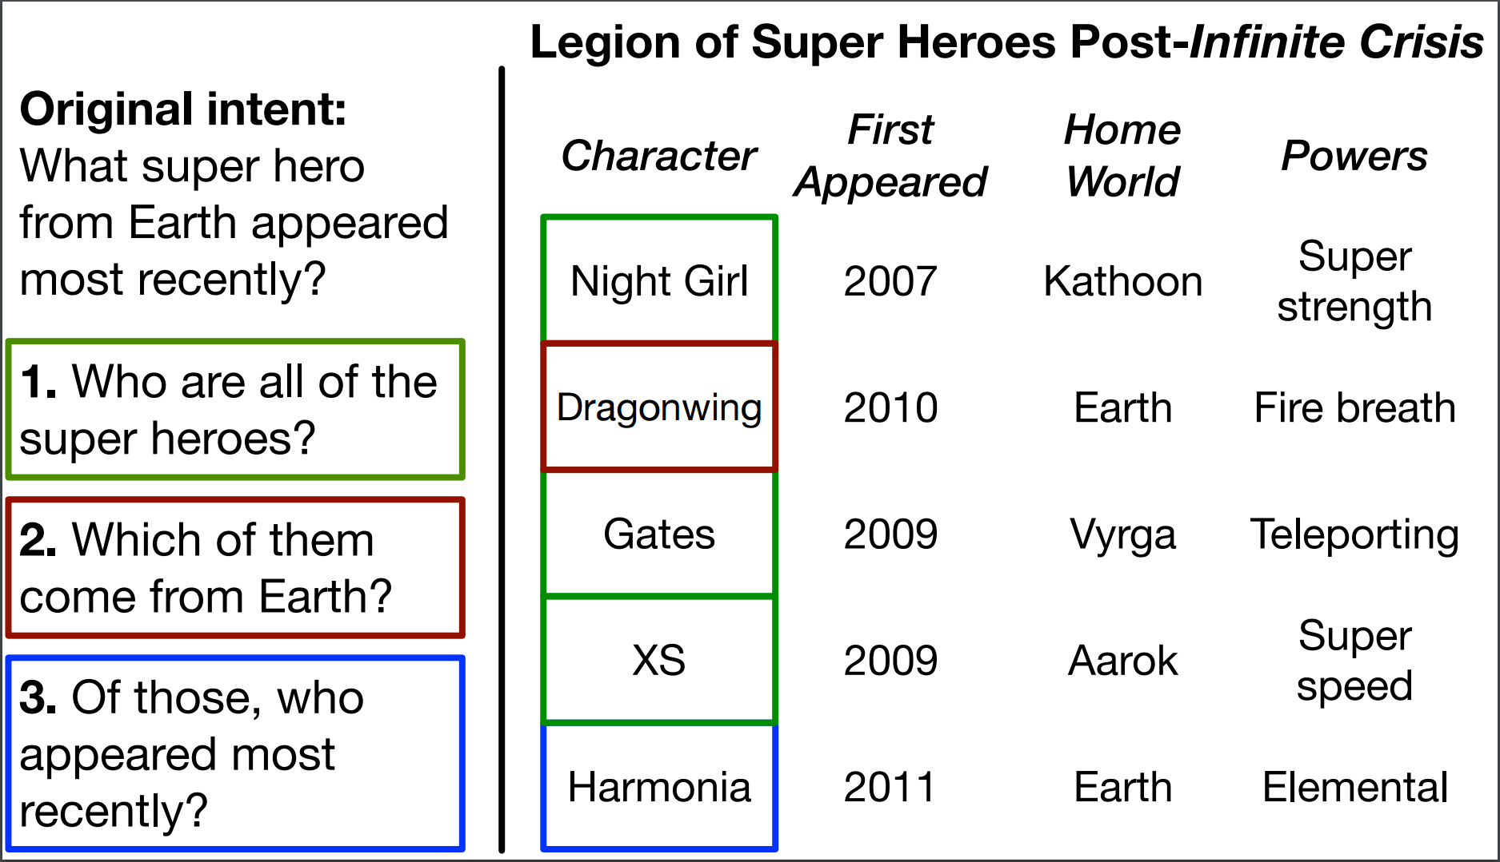
Our Task: Sequential Question Answering (SQA)
MSR SQA Dataset (aka.ms/sqa)
Sequences of questions, with annotated answers (coordinates)

Slide 21
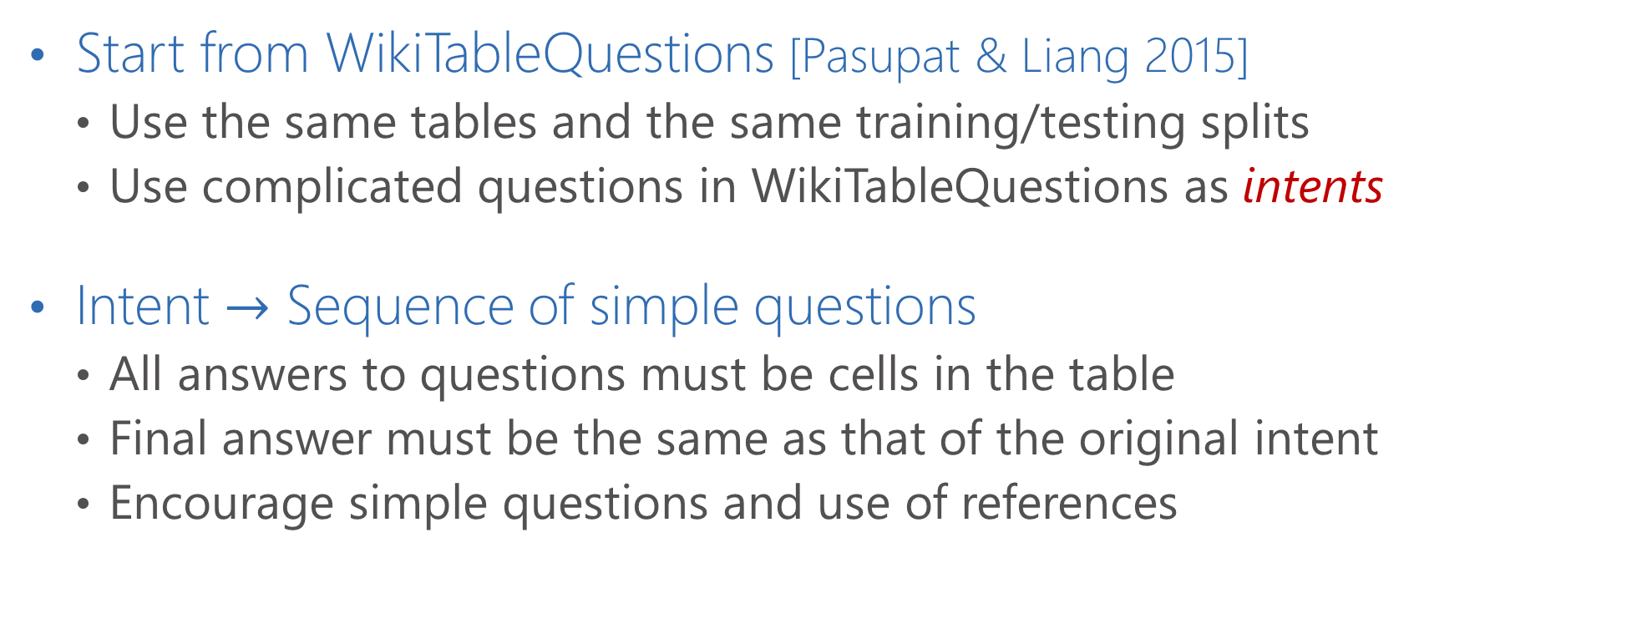
SQA Dataset Creation (1/2)
Start from WikiTableQuestions [Pasupat & Liang 2015]
Use the same tables and the same training/testing splits
Use complicated questions in WikiTableQuestions as intents
Intent $→$ Sequence of simple questions
All answers to questions must be cells in the table
Final answer must be the same as that of the original intent
Encourage simple questions and use of references

Slide 22
SQA Dataset Creation (2/2)
Original Intent
What super hero from Earth appeared most recently?
Sequence of simple questions
Who are all of the super heroes?
Which of them came from Earth?
Of those, who appeared most recently?
Data statistics
2,022 intents
6,066 question sequences (3 annotators per intent)
17,533 total questions (~2.9 questions per sequence)

Slide 23
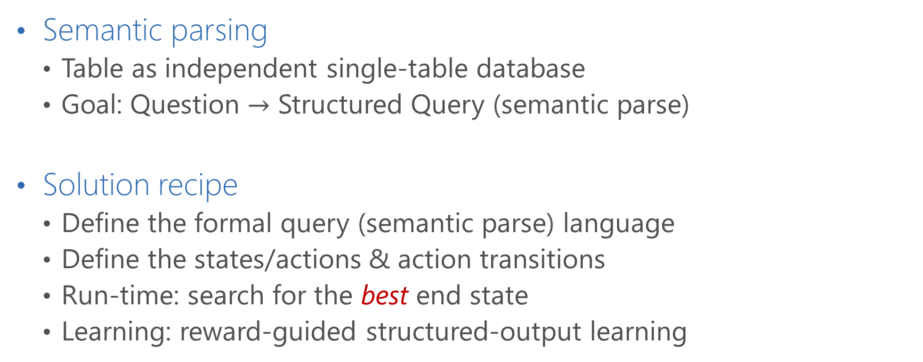
Approach: Dynamic Semantic Parser (DynSP)
Semantic parsing
Table as independent single-table database
Goal: Question $→$ Structured Query (semantic parse)
Solution recipe
Define the formal query (semantic parse) language
Define the states/actions & action transitions
Run-time: search for the best end state
Learning: reward-guided structured-output learning

Slide 24
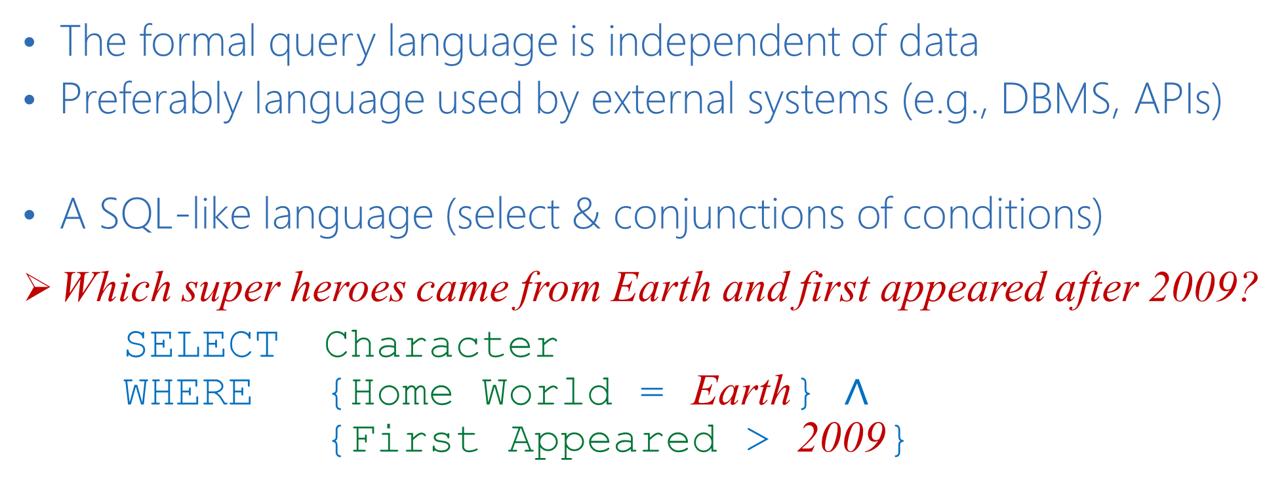
Formal Query Language
The formal query language is independent of data
Preferably language used by external systems (e.g., DBMS, APIs)
A SQL-like language (select & conjunctions of conditions)
Which super heroes came from Earth and first appeared after 2009?
SELECT Character WHERE {Home World = Earth} $∧$ {First Appeared > 2009}

Slide 25
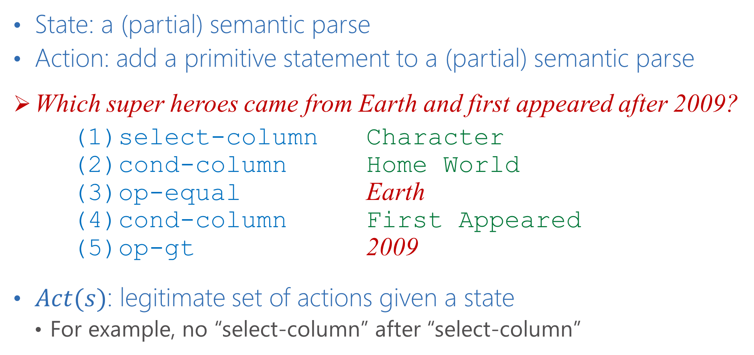
States & Actions
State: a (partial) semantic parse
Action: add a primitive statement to a (partial) semantic parse
Which super heroes came from Earth and first appeared after 2009?
(1)select-column Character (2)cond-column Home World (3)op-equal Earth (4)cond-column First Appeared (5)op-gt 2009
$Act(s)$: legitimate set of actions given a state
For example, no “select-column” after “select-column”

Slide 26






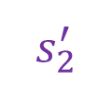




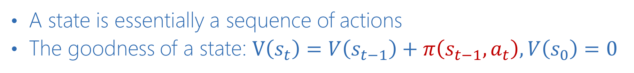
Search
Which super heroes came from Earth?
(1)select-column Character (2)cond-column Home World (3)op-equal Earth
$$s_{1}$$
Cond on “Home World”
$$s_{2}$$
Select “Character”
Value = “Earth”
$$s_{0}$$
$$⋯$$
$$s_{3}$$
$$s_{1}^{′}$$
$$⋯$$
$$s_{2}^{′}$$
$$⋯$$
Select “Powers”
$$s_{1}^{′′}$$
$$s_{2}^{′′}$$
A state is essentially a sequence of actions
The goodness of a state: $V\left(s_{t}\right)=V\left(s_{t−1}\right)+π\left(s_{t−1},a_{t}\right), V\left(s_{0}\right)=0$

Slide 27
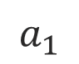
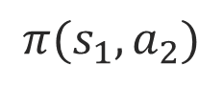
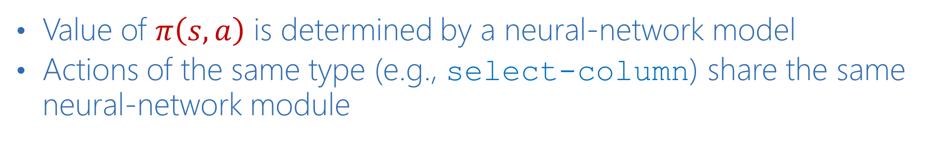
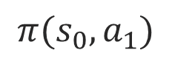

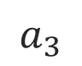
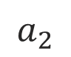
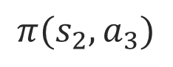
Neural Network Modules (1/2)
Value of $π\left(s,a\right)$ is determined by a neural-network model
Actions of the same type (e.g., select-column) share the same neural-network module
Which super heroes came from Earth? ,
$$a_{1}$$
$$a_{2}$$
$$a_{3}$$
$$s_{0}$$
Select “Character”
$$s_{1}$$
Cond on “Home World”
$$s_{2}$$
Value = “Earth”
$$s_{3}$$
$$π(s_{0},a_{1})$$
$$π(s_{1},a_{2})$$
$$π(s_{2},a_{3})$$

Slide 28
Neural Network Modules (2/2)
Modules are selected dynamically as search progresses
Similar to [Andreas et al. 2016], but structures are not pre-determined
Network design reflects the semantics of the action
Select “Character”
Bi-LSTM Word Embedding
character
Word Embedding initialized with GloVe
Q: Which super heroes came from Earth?

Slide 29
Maximum Margin Reward Learning [EMNLP-2017]
Indirect supervision: only answers are available
A Perceptron-like algorithm:
Find the reference semantic parse that evaluates to the gold answers
Find the predicted semantic parse based on the current model
Derive loss by comparing them; update model parameters by stochastic gradient decent

Slide 30

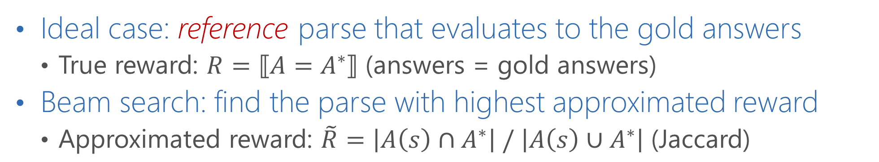
Find the Reference Semantic Parse
Ideal case: reference parse that evaluates to the gold answers
True reward: $R=⟦A=A^{∗}⟧$ (answers = gold answers)
Beam search: find the parse with highest approximated reward
Approximated reward: $\tilde{R}=\left|A\left(s\right)∩A^{∗}\right| / \left|A\left(s\right)∪A^{∗}\right|$ (Jaccard)
$Q=$ “Which super heroes came from Earth?”, $A^{∗}=$ {Dragonwing, Harmonia}
$$s_{1}$$
Cond on “Home World”
$$s_{2}$$
Select “Character”
Value = “Earth”
$$s_{0}$$
$$⋯$$
$$s_{3}$$
$$s_{1}^{′}$$
$$⋯$$
$$s_{2}^{′}$$
$$⋯$$
Select “Powers”
$$s_{1}^{′′}$$
$$s_{2}^{′′}$$

Slide 31
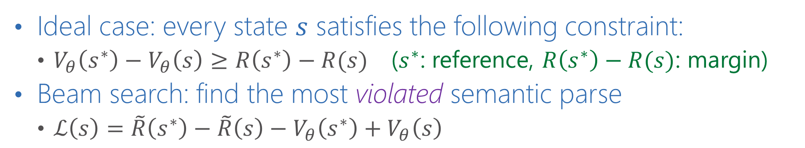
Find the Predicted Semantic Parse
Ideal case: every state $s$ satisfies the following constraint:
$V_{θ}\left(s^{∗}\right)−V_{θ}\left(s\right)≥R\left(s^{∗}\right)−R(s)$ ($s^{∗}$: reference, $R\left(s^{∗}\right)−R(s)$: margin)
Beam search: find the most violated semantic parse
$ℒ\left(s\right)=\tilde{R}\left(s^{∗}\right)−\tilde{R}\left(s\right)−V_{θ}\left(s^{∗}\right)+V_{θ}\left(s\right)$
$Q=$ “Which super heroes came from Earth?”, $A^{∗}=$ {Dragonwing, Harmonia}
$$s_{1}$$
Cond on “Home World”
$$s_{2}$$
Select “Character”
Value = “Earth”
$$s_{0}$$
$$⋯$$
$$s_{3}$$
$$s_{1}^{′}$$
$$⋯$$
$$s_{2}^{′}$$
$$⋯$$
Select “Powers”
$$s_{1}^{′′}$$
$$s_{2}^{′′}$$

Slide 32
Extension to Question Sequence
For questions that are not the first in a sequence, allow a special subsequent statement
Modules of subsequent conditions consider both previous and current questions
Answers would be a subset of previous answers
Which super heroes came from Earth?
Which of them breathes fire?
SUBSEQUENT WHERE {Powers = Fire breath}

Slide 33
Existing Systems for WikiTableQuestions
Floating Parser (FP) [Pasupat & Liang. ACL-15] (37.1% accuracy)
Map questions to logical forms
Feature-rich system that aims to output the correct semantic parse
Neural Programmer (NP) [Neelakantan et al. ICLR-17] (37.7% accuracy)
Neural modules that are not tied to a specific formal language
Output a probability distribution over table cells given a question
Neural Semantic Parsing with Type Constraints [Krishnamurthy, Dasigi & Gardner. EMNLP-17] (45.9% accuracy)
Current state of the art on WikiTableQuestions

Slide 34
Results: Answer Accuracy (%)

Slide 35
Results: Answer Accuracy (%)

Slide 36
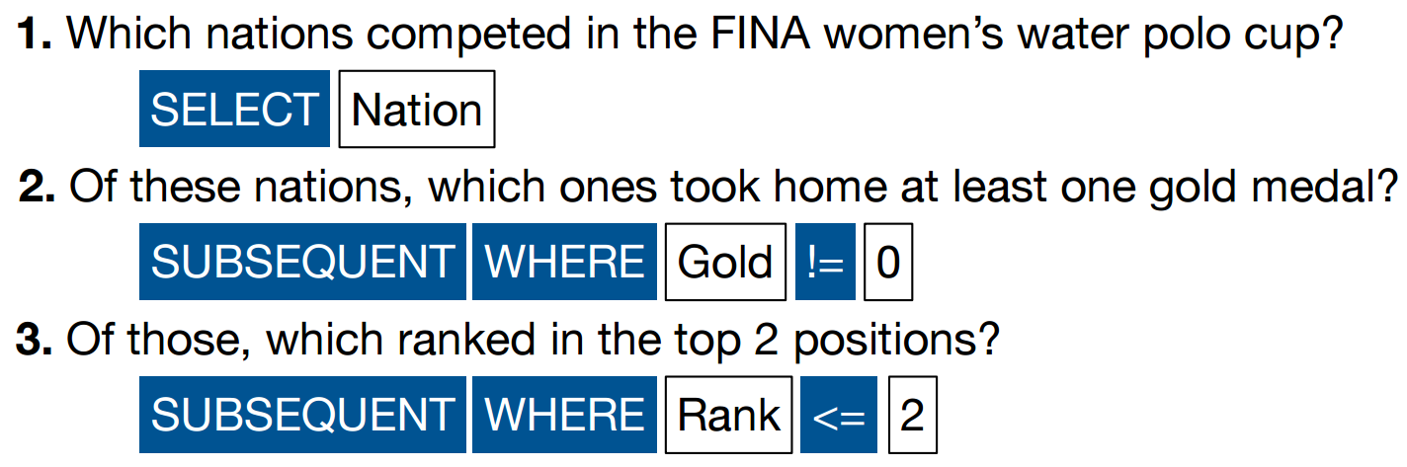
Successful Example

Slide 37
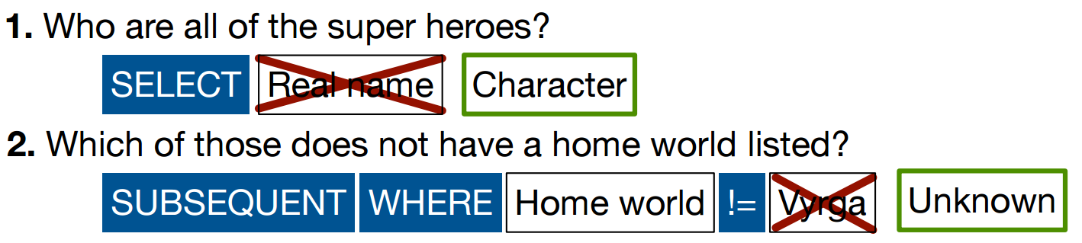
Semantic Matching Errors

Slide 38
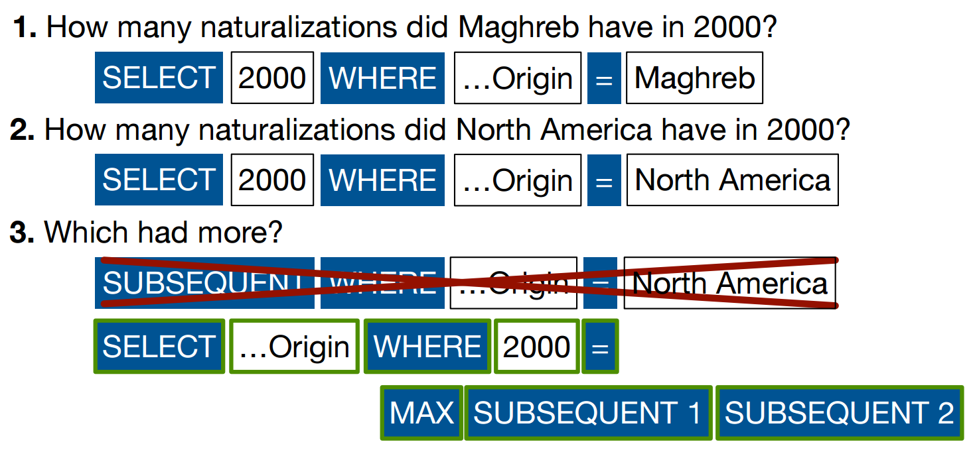
Insufficient Expressiveness

Slide 39
Reflections on DynSP
An end-to-end joint learning framework
Formulated as a state/action search problem
Neural networks constructed dynamically as search progresses
A first step towards “Conversational QA”
Next steps
Efficient training to test more expressive formal languages and neural network modules
External data or interactive learning for better semantic matching

Slide 40
Summary
Introduction to various semantic parsing problems
Common technical challenges
Scarce Labeled Data
Complex Semantic Matching
Compositionality & Contextual setting
Large Search Space
DynSP for Sequential Question Answering
A more natural question answering scenario
More on the learning framework:
Peng, Chang & Yih, “Maximum Margin Reward Networks for Learning from Explicit and Implicit Supervision” [EMNLP-17]

Slide 41
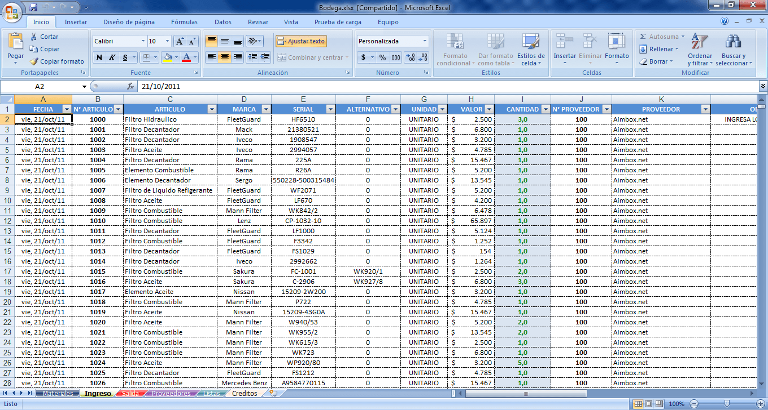


Future: Semantic Parsing
Critical component for natural language interface (NLI)
The bridge between human languages and structured data
Enable easy use of any feature-rich systems or software components
Key to success:
Large data with various kinds of supervision signals
Novel and advanced structured prediction learning algorithms

